Slide 1
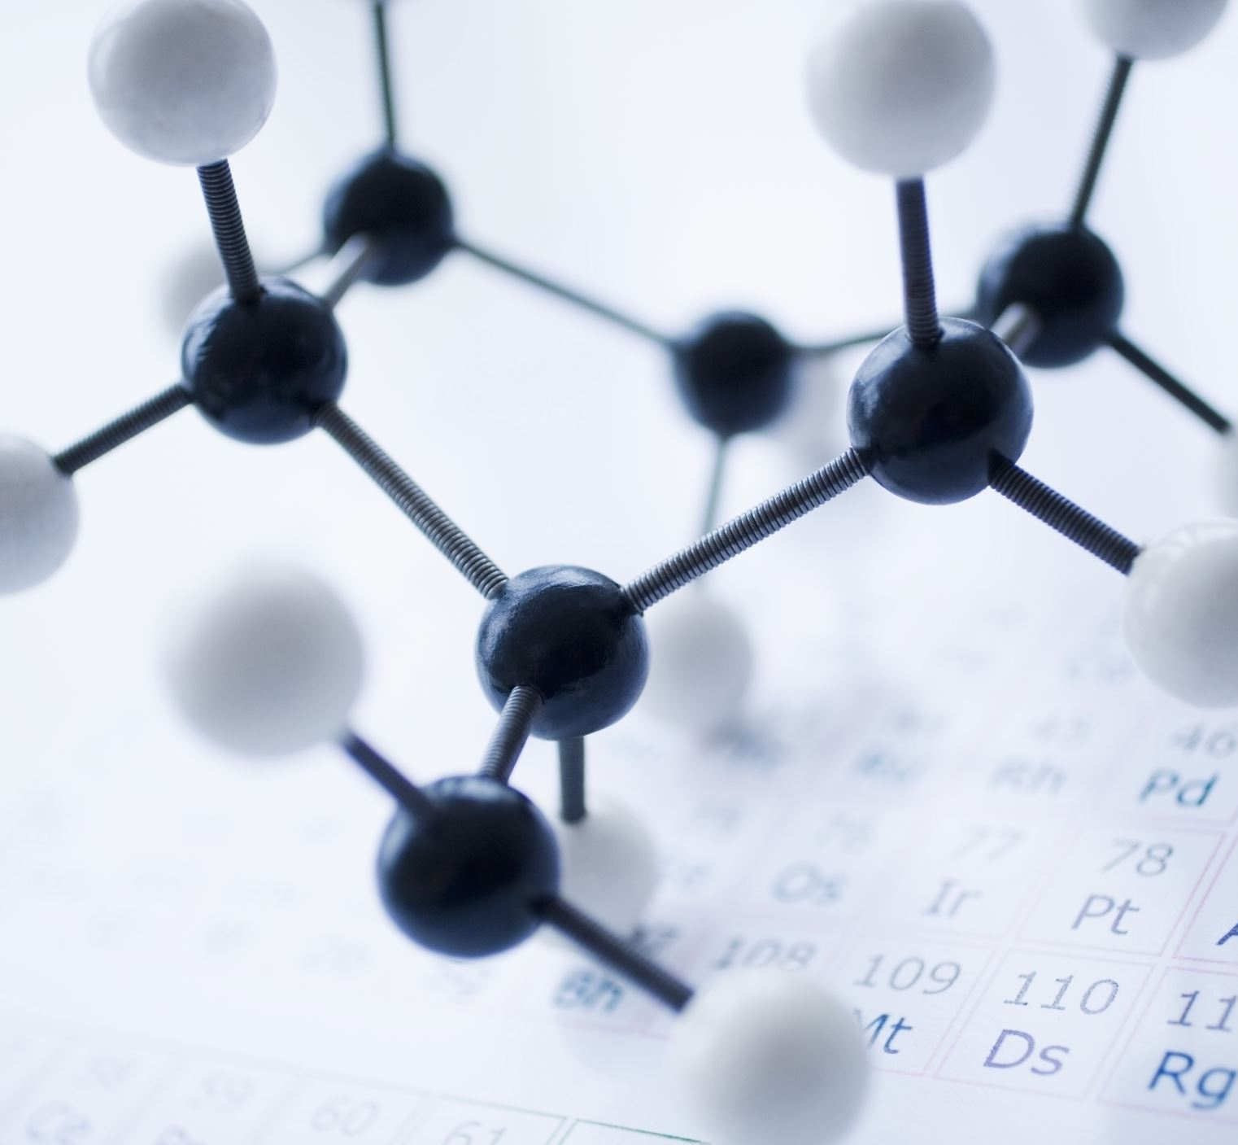
Use of Organic Materials for the Fabrication of Flexible Memory
Seth So

Slide 2
Content Overview
Evolution of Flexible Electronics
Fabrication Methods
Mechanisms of Modern Devices
Photopolymers
Quantum Dot
Ionic Nanocluster
Summary & Conclusions

Slide 3
Flexible Electronics
Flexible Electronics have been rapidly growing, nearing commercial viability
Such circuitry and integrated systems will eventually call for flexible memory
Organic bases have opened many memory mechanisms
Continual research is yielding improvements at a promising rate

Slide 4
Fabrication Methods

Slide 5
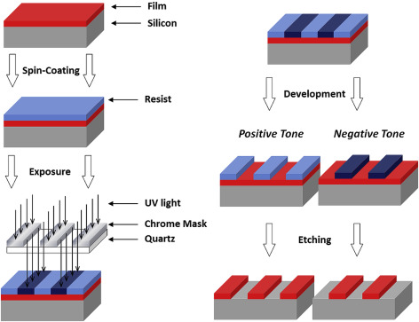
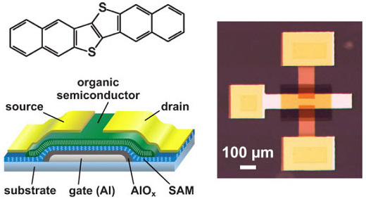
Fabrication Methods
Spin + Lithography
Ink Jet printing
Laser Jet printing
Roll-to-Roll methods
Photos from: R. Lawson (Ref. 1)
U. Scheischang (Ref. 2)

Slide 6
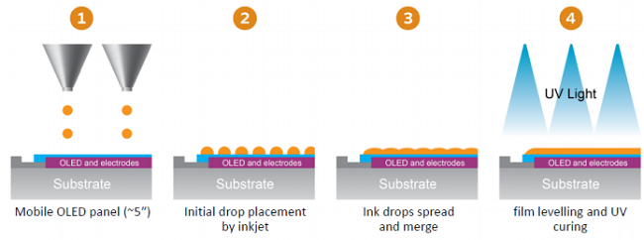
Fabrication Methods
Spin + Lithography
Ink Jet printing
Laser Jet printing
Roll-to-Roll methods
Photo from: Phoseon Technology

Slide 7
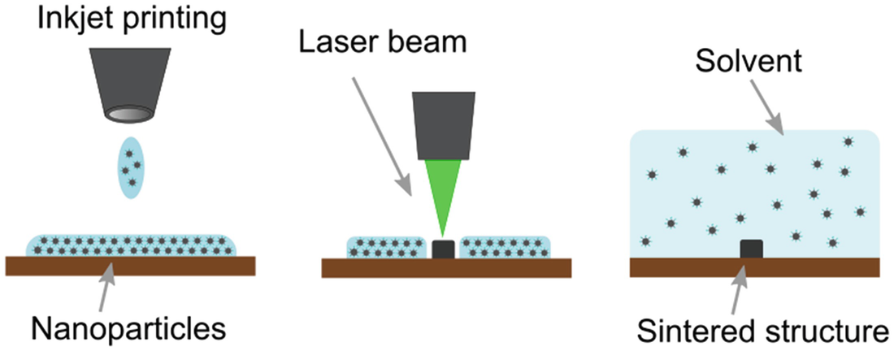
Fabrication Methods
Spin + Lithography
Ink Jet printing
Laser Jet printing
Roll-to-Roll methods
Photo from: O. Kravchuk (Ref. 3)

Slide 8
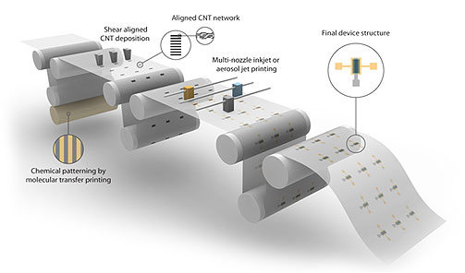
Fabrication Methods
Spin + Lithography
Ink Jet printing
Laser Jet printing
Roll-to-Roll methods
Photo from: University of Minnesota, MURI

Slide 9
Devices and Mechanisms

Slide 10
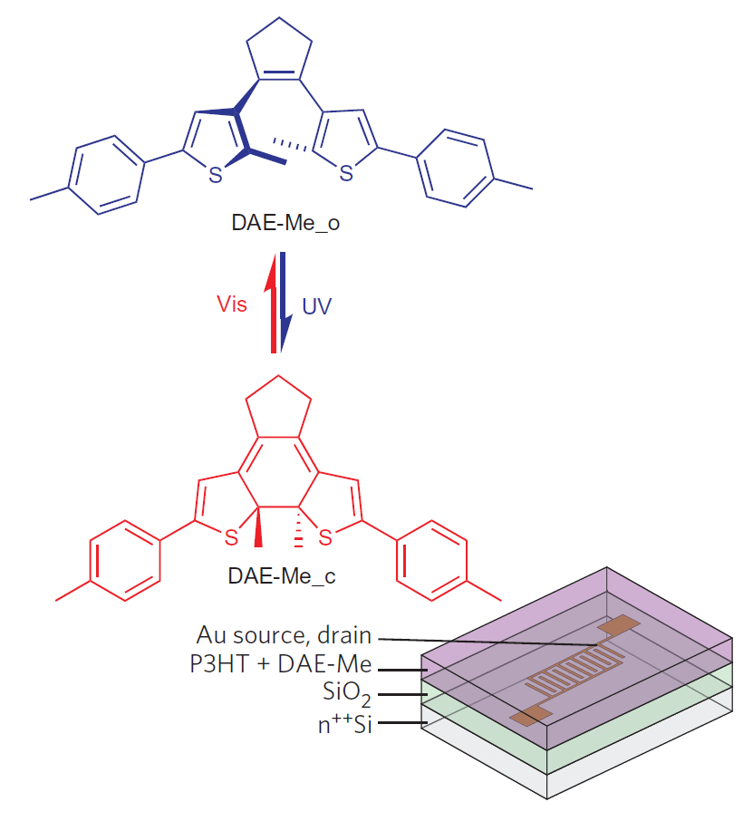
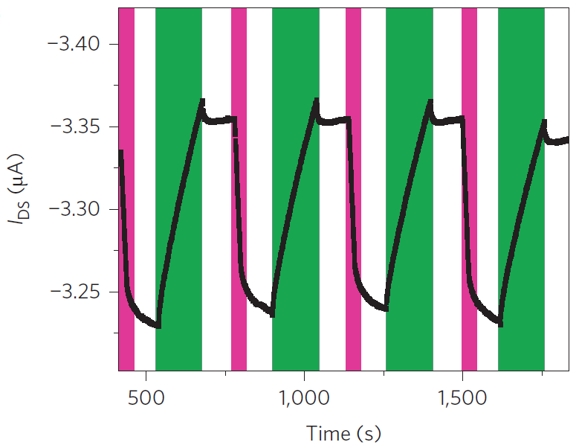
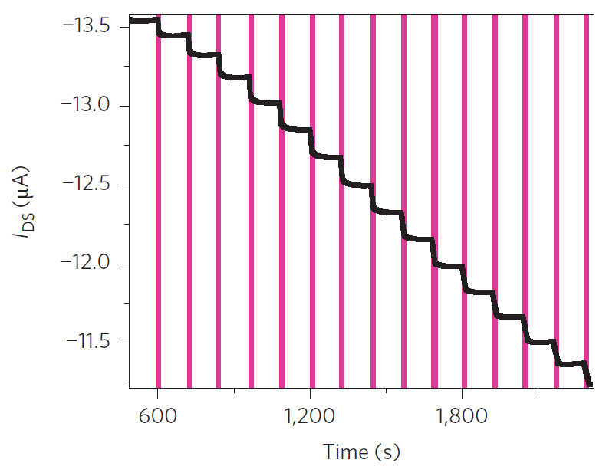
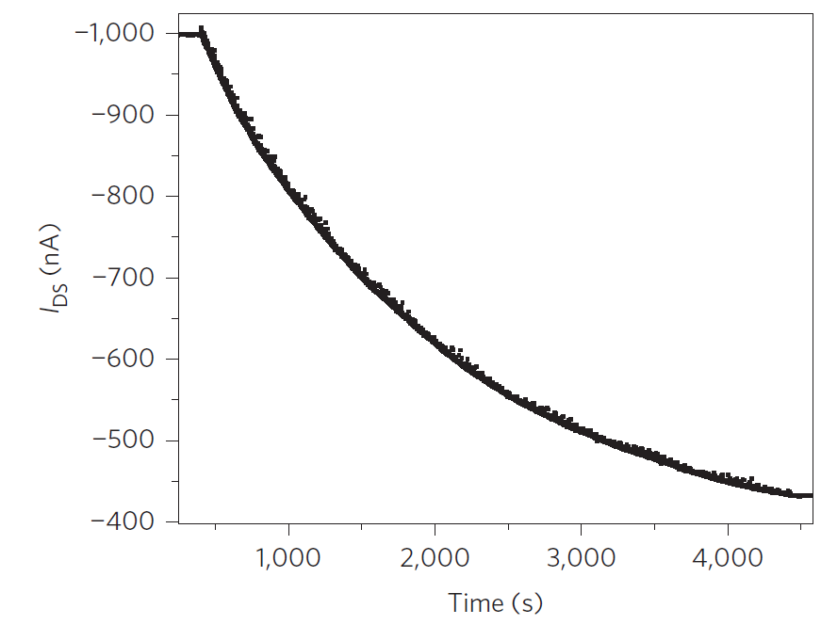
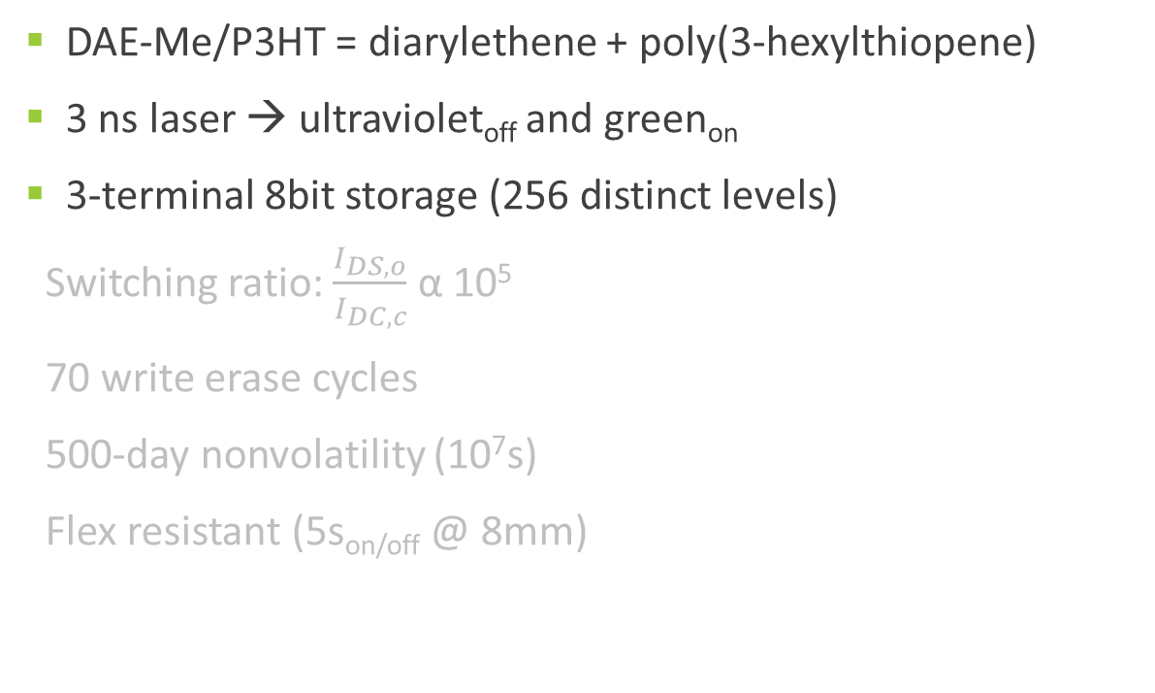
Photopolymers
(device)
DAE-Me/P3HT = diarylethene + poly(3-hexylthiopene)
3 ns laser → ultraviolet_{off} and green_{on}
3-terminal 8bit storage (256 distinct levels)
Switching ratio: $\frac{I_{DS,o}}{I_{DC,c}}$ α 10⁵
70 write erase cycles
500-day nonvolatility (10⁷s)
Flex resistant (5s_{on/off} @ 8mm)
Photos from: T. Leydecker (Ref. 4)

Slide 11
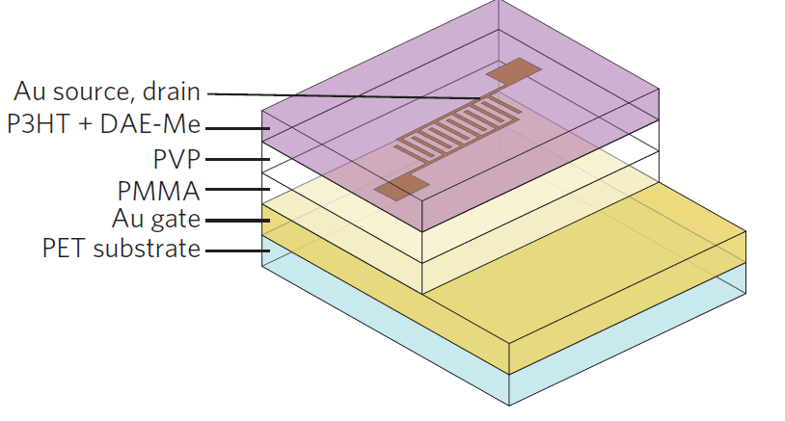
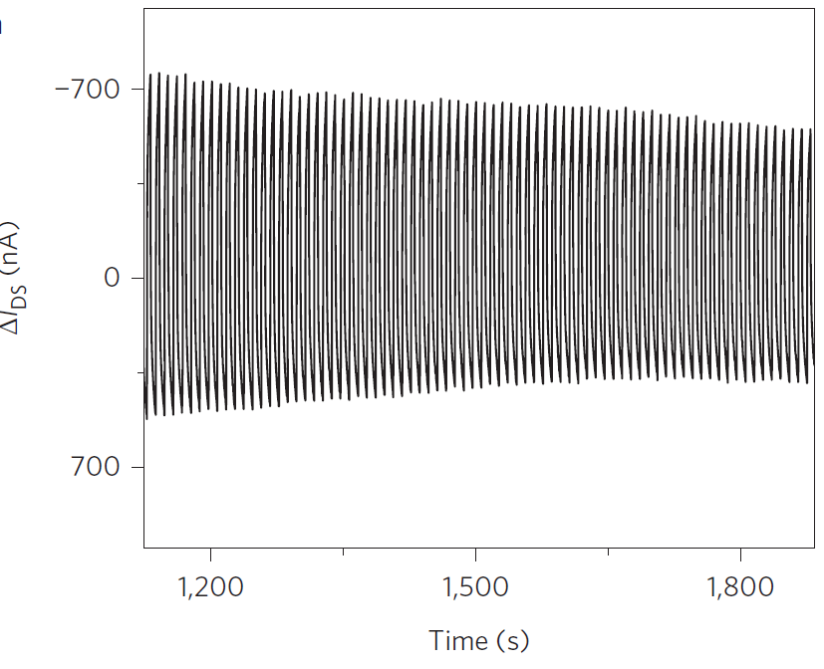
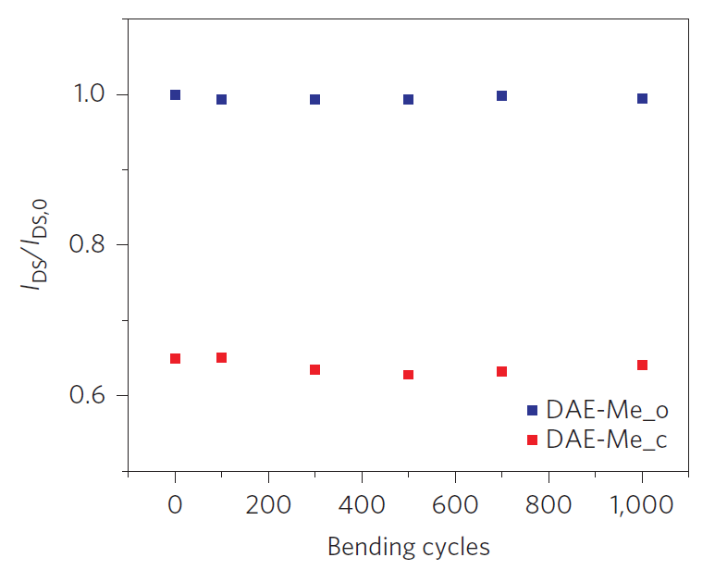
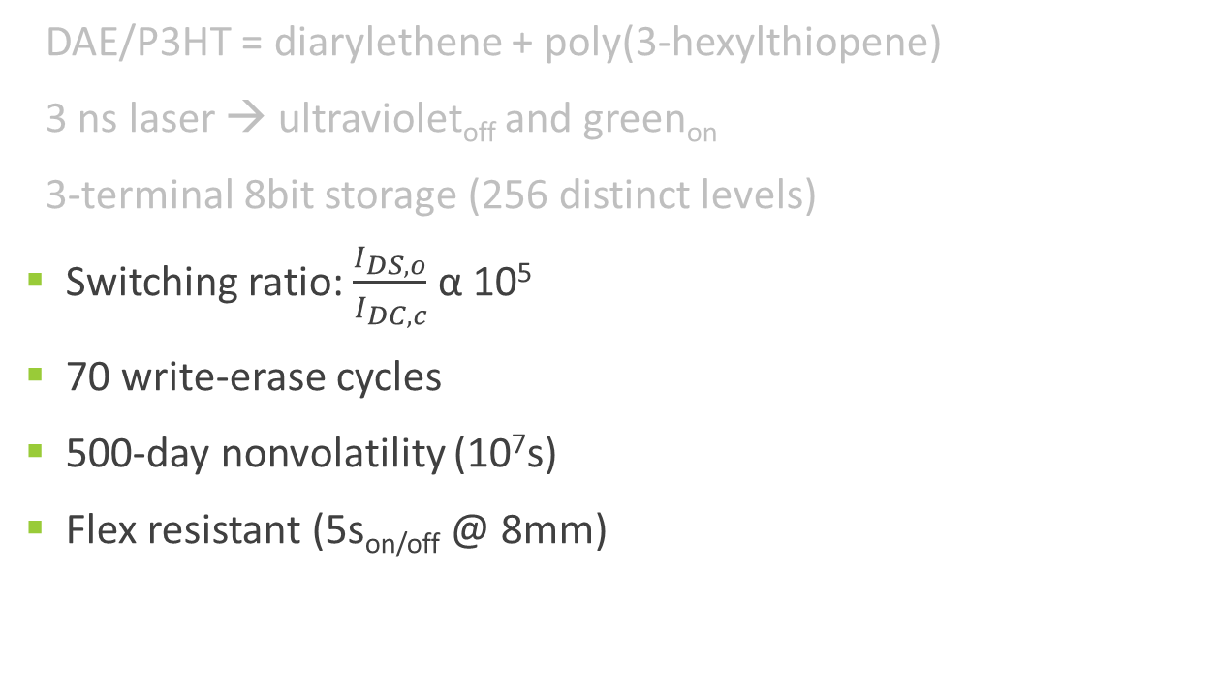
Photopolymers
(characterization)
DAE/P3HT = diarylethene + poly(3-hexylthiopene)
3 ns laser → ultraviolet_{off} and green_{on}
3-terminal 8bit storage (256 distinct levels)
Switching ratio: $\frac{I_{DS,o}}{I_{DC,c}}$ α 10⁵
70 write-erase cycles
500-day nonvolatility (10⁷s)
Flex resistant (5s_{on/off} @ 8mm)
Photos from: T. Leydecker (Ref. 4)

Slide 12
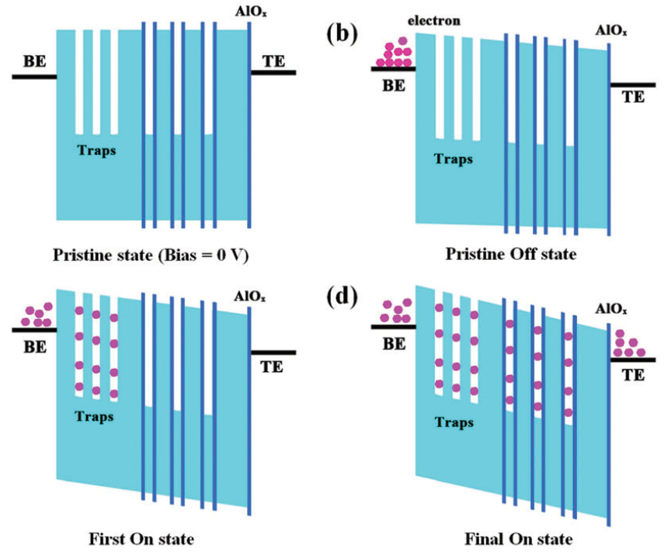
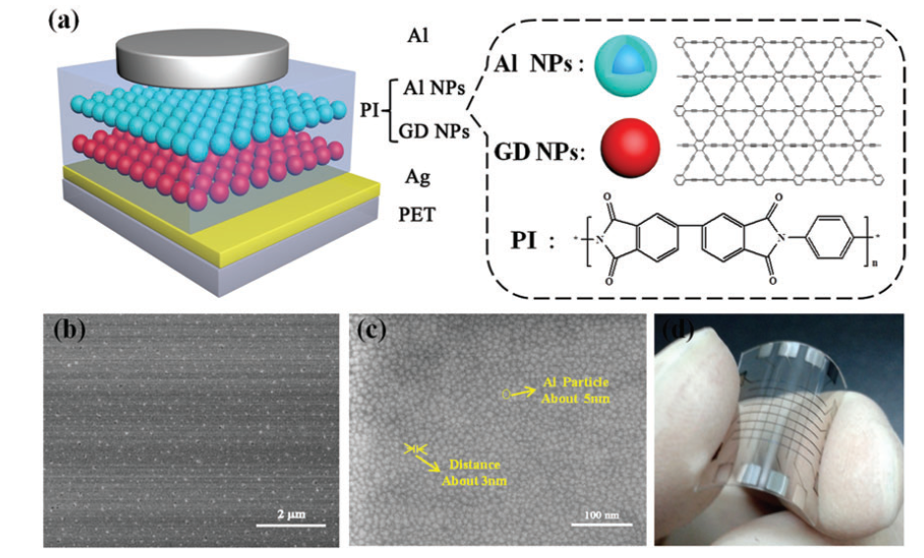
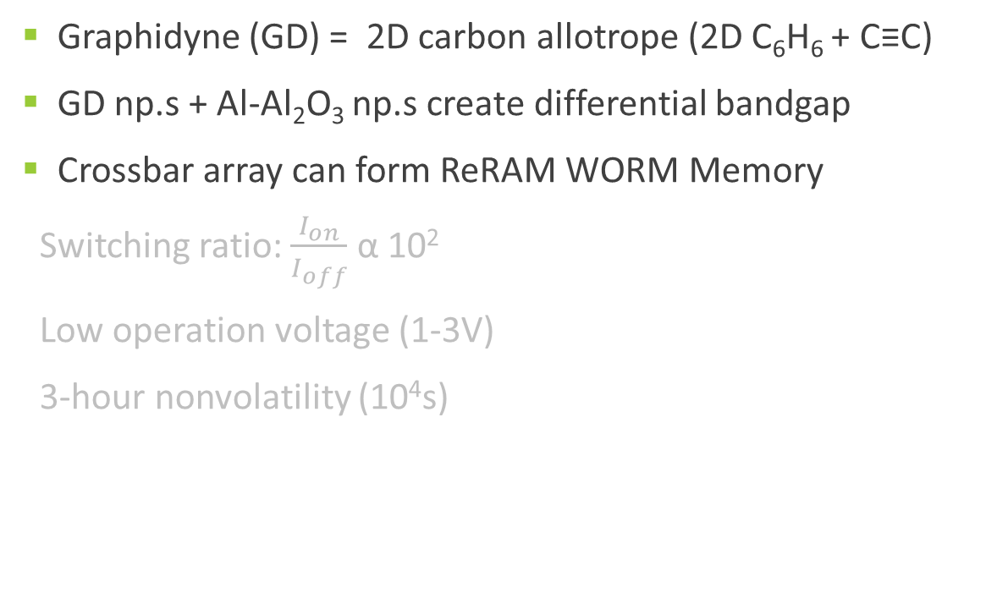
Graphidyne
(device)
Graphidyne (GD) = 2D carbon allotrope (2D C₆H₆ + C≡C)
GD np.s + Al-Al₂O₃ np.s create differential bandgap
Crossbar array can form ReRAM WORM Memory
Switching ratio: $\frac{I_{on}}{I_{off}}$ α 10²
Low operation voltage (1-3V)
3-hour nonvolatility (10⁴s)
Photos from: Z. Jin (Ref. 5)

Slide 13
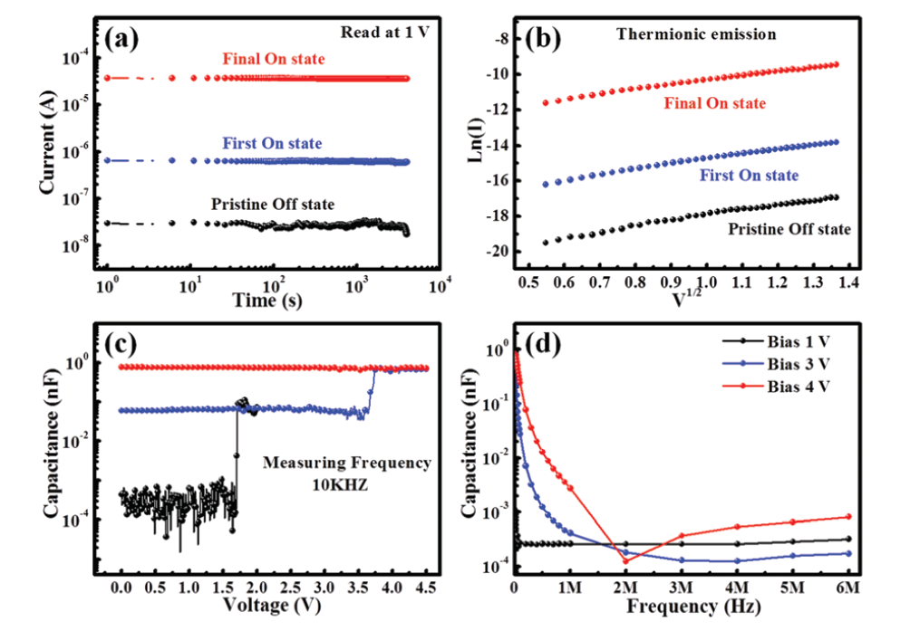
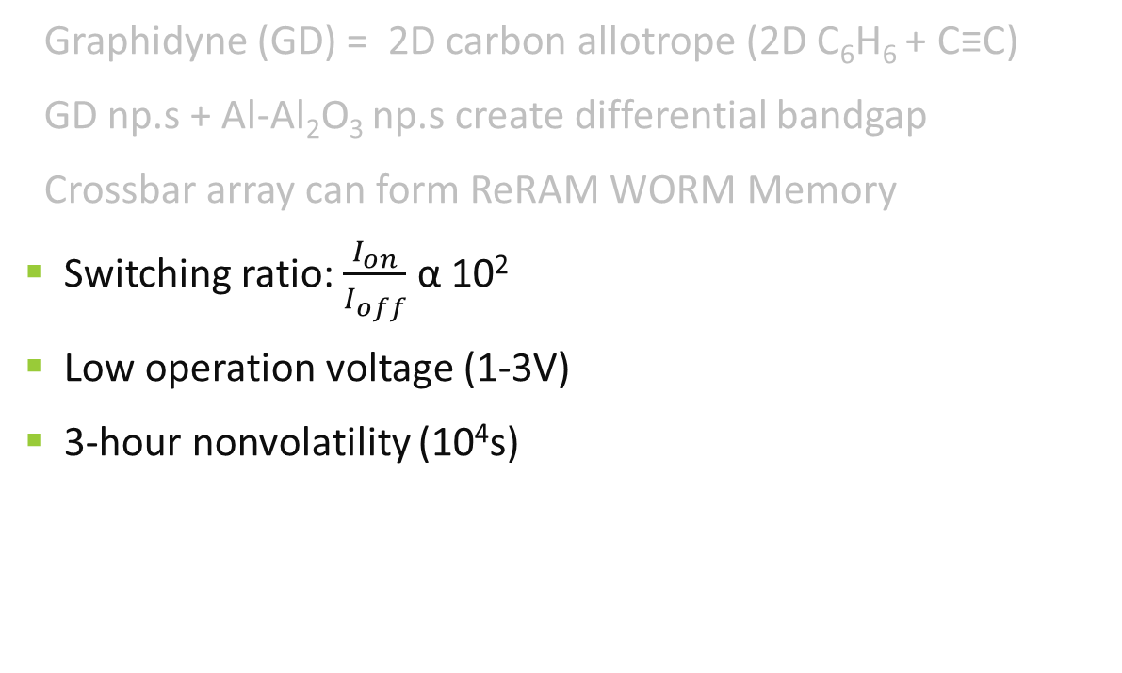
Graphidyne
(characterization)
Graphidyne (GD) = 2D carbon allotrope (2D C₆H₆ + C≡C)
GD np.s + Al-Al₂O₃ np.s create differential bandgap
Crossbar array can form ReRAM WORM Memory
Switching ratio: $\frac{I_{on}}{I_{off}}$ α 10²
Low operation voltage (1-3V)
3-hour nonvolatility (10⁴s)
Photos from: Z. Jin (Ref. 5)

Slide 14
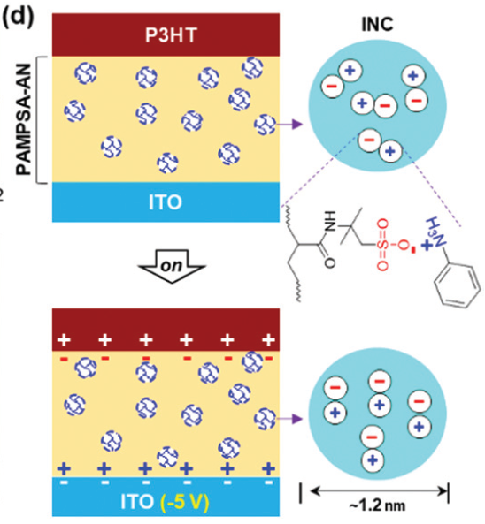
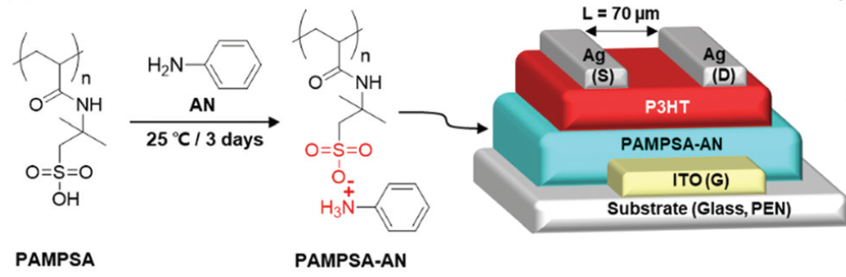
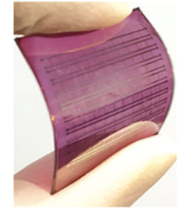
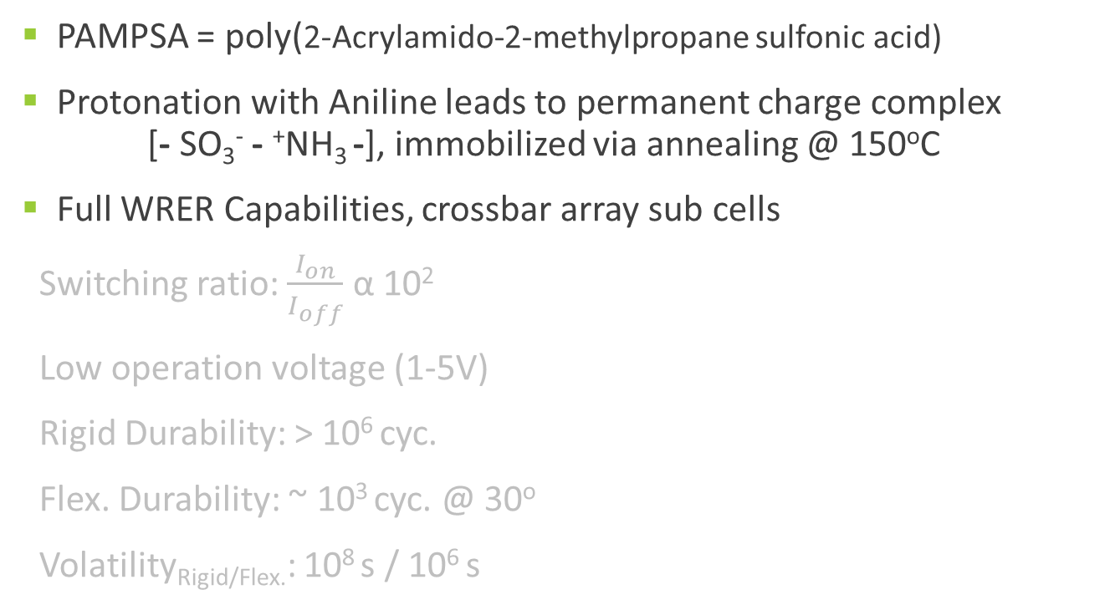
Ionic Nanoclusters
(device)
PAMPSA = poly(2-Acrylamido-2-methylpropane sulfonic acid)
Protonation with Aniline leads to permanent charge complex [- SO₃⁻ - ⁺NH₃ -], immobilized via annealing @ 150ºC
Full WRER Capabilities, crossbar array sub cells
Switching ratio: $\frac{I_{on}}{I_{off}}$ α 10²
Low operation voltage (1-5V)
Rigid Durability: > 10⁶ cyc.
Flex. Durability: ~ 10³ cyc. @ 30º
Volatility_{Rigid/Flex.}: 10⁸ s / 10⁶ s
Photos from: C. Lee (Ref. 6)

Slide 15
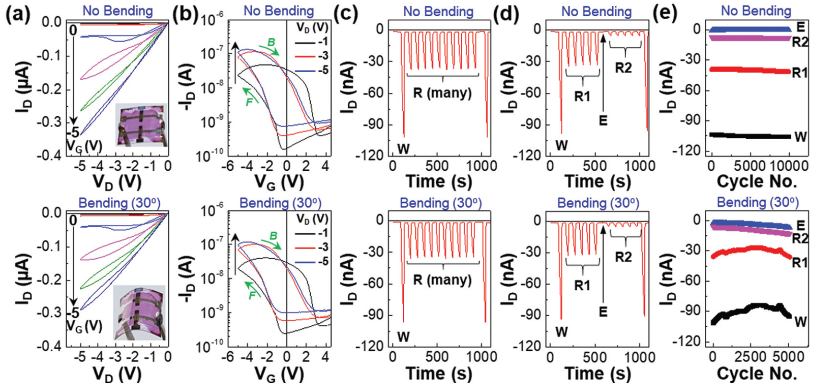

Ionic Nanoclusters
(characterization)
PAMPSA = poly(2-Acrylamido-2-methylpropane sulfonic acid)
Protonation with Aniline leads to permanent charge complex [- SO₃⁻ - ⁺NH₃ -], immobilized via annealing @ 150ºC
Full WRER Capabilities, crossbar array sub cells
Switching ratio: $\frac{I_{on}}{I_{off}}$ α 10²
Low operation voltage (1-5V)
Rigid Durability: > 10⁵ cyc.
Flex. Durability: ~ 10³ cyc. @ 30º
Volatility_{Rigid/Flex.}: 10⁸ s / 10⁶ s
Photos from: C. Lee (Ref. 6)

Slide 16
Summary & Conclusions
 | Advantages | Disadvantages
Photopolymers | High storage density, flex resistant, non-volatile, simple structure | Power intensive, high voltage operation, slow switching speed
Graphidyne | Easily scalable and altered, fast switching speed, simple structure | Low voltage operation, low switch ratio, relatively volatile
Ionic Nanoclusters | Extremely durable, flex resistant, non-volatile, high hysteresis, simple structure | Low voltage operation, low switch ratio, slow switching speed
Necessary Improvements: Faster switching speeds (μ and relaxation), scaling to practical level, reliable durability and volatility
Much potential for development, but significant advances needed before becoming practically viable.

Slide 17
References
Lawson, R., Robinson, A., 2016. Frontiers of Nanoscience. 11. 1-90.
Zschieschang, U., Ante, F., Yamamoto, T., et al., 2010. Advanced Materials. 22. 982-985.
Kravchuck, O., Lesyuk, R., Bobitski, Y., et al. 2018. NANO 2017. Spring Proceedings in Physics. 210. 317-339.
Leydecker, T., Herder, M., Pavlica, E., et al., 2016. Nature: Nanotechnology. 11. 769-777.
Jin, Z., Chen, Y., Zhou, Q., et al., 2017. Materials: Chemistry. 1. 1338-1341
Lee, C., Jeong, J., Kim, H., et al., 2019. Materials: Horizons. 6. 1899-1905

